Slide 1
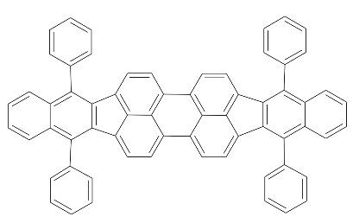
a
b
DBP
c
d
Notes:
Figure1. (a) Molecular structure of Meo-TPD: 3TPYMB (TADF Host) and DBP (dopant) molecules. (b) Absorption and photoluminescence for Meo-TPD: 3TPYMB and DBP thin film. (c) The PL spectra of the 0.5% to 4.0% DBP doped Meo-TPD: 3TPYMB (1:4) thin film at room and low temperatures. (d) Schematics of the MEL mechanism of the device, where two spin-mixing channels exist; the spin mixing (i) of polaron pairs through the hyperfine interaction (HFI), and the spin mixing (ii) of exciplex through Δg mechanism.

Slide 2
PL vs λ
0.5%
MeO-TPD (20%):3TPYMB(80%):DBP (0.5%)

Slide 3
1% PL vs λ
MeO-TPD (20%):3TPYMB(80%):DBP (1%)
Remove this peak

Slide 4
2% PL vs λ
MeO-TPD (20%):3TPYMB(80%):DBP (2%)
Remove this peak

Slide 5
4% PL vs λ
MeO-TPD (20%):3TPYMB(80%):DBP (4%)
Remove this peak

Slide 6
6% PL vs λ
MeO-TPD (20%):3TPYMB(80%):DBP (6%)

Slide 7
Ph-OLED PL spectrum
TCTA(10nm)/TCTA:B3PY:Ir(ppy)3(1:3:0.2)/B3PY(40nm)/LiF/Al

Slide 8
TCTA(10nm)/TCTA:B3PY(ratio)/B3PY(40nm)/LiF/Al
TCTA(10nm)/TCTA:B3PY(50%:50%): Irppy3 (doped molecule, 0.2%)/B3PY(40nm)/LiF/Al

